Slide 1

Huawei HCCDA-AI certification
Instructor : Fawad Bahadur

Slide 2
Machine Learning Basics
Machine Learning Algorithms and Applications in Python
Dated: 19 July 2025
Instructor : Fawad Bahadur

Slide 3

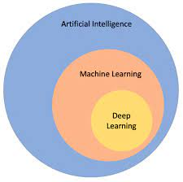
What is Machine Learning?
Machine Learning (ML) is the part of AI that lets computers learn from data and get better on their own—no step-by-step programming needed.
“Machine learning is the science of getting computers to act without being explicitly programmed.” — Arthur Samuel
Data
Learning Algorithm
Model
Predictions

Slide 4
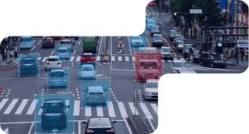


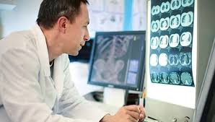

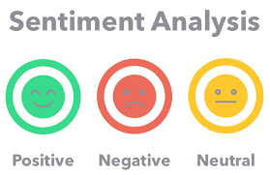
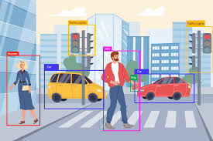
Where ML is Used Today
Face recognition
Object detection
Chatbots
Recommendation systems
Autonomous vehicles
Disease diagnosis
Sentiment analysis
Yield estimation
Fraud detection

Slide 5
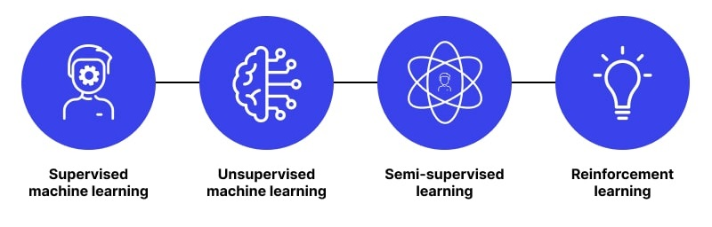
Types of Machine Learning

Slide 6
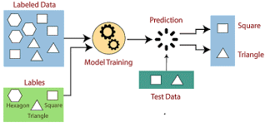
Supervised Learning
Definition:
The model learns from labeled data to make predictions.
X → Y
Examples:
Spam email detection, house price prediction, image classification.
Size (x) | Price (y)
2104 | 460
1416 | 232
1534 | 315
852 | 178
… | …

Slide 7
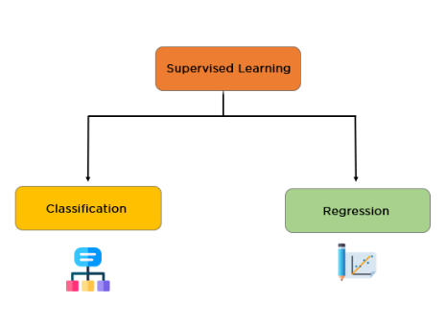
Types of Supervised Learning Tasks

Slide 8
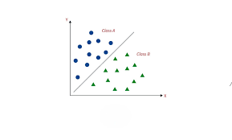

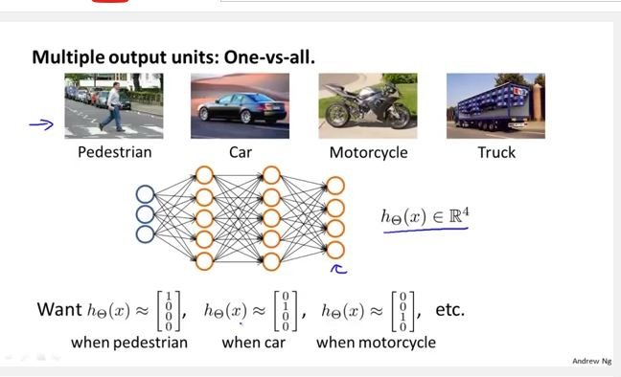
Classification
Definition:
Predicts discrete labels or categories.
Goal:
Assign an input to one of several predefined classes.
Examples:
Email spam detection (Spam / Not Spam)
Image recognition (Pedestrian, Car, Motorcycle or Truck)

Slide 9
Binary Classification
Definition:
Classification task with two possible outcomes.
Label Format:
Usually 0 and 1 (or True/False)
Examples:
Spam vs. Not Spam
Disease: Positive vs. Negative
Pass vs. Fail
Real vs Fake

Slide 10
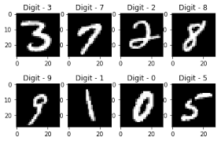
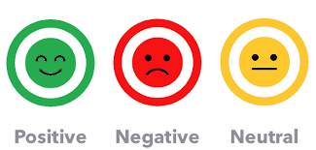
Multi-Class Classification
Definition:
Classification task with more than two classes.
Label Format:
Classes like 0, 1, 2, ..., or Cat, Dog, Horse
Examples:
Handwritten digit recognition (0–9)
Animal type (Cat, Dog, Horse)
Sentiment analysis (Negative, Neutral, Positive)

Slide 11
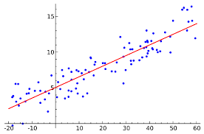
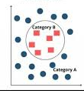
Regression
Definition:
Predicts continuous numerical values.
Goal:
Estimate a real value based on input features.
Examples:
Predicting house prices
Forecasting temperature

Slide 12
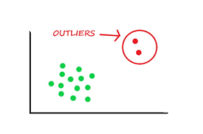
Understanding Outliers
An outlier is a data point that significantly differs from other observations in the dataset.
It doesn’t follow the pattern of the rest of the data.
Examples
A person earning $10 million in a dataset where others earn $30k–$80k.
Temperature reading of 1000°C in a normal weather dataset.

Slide 13
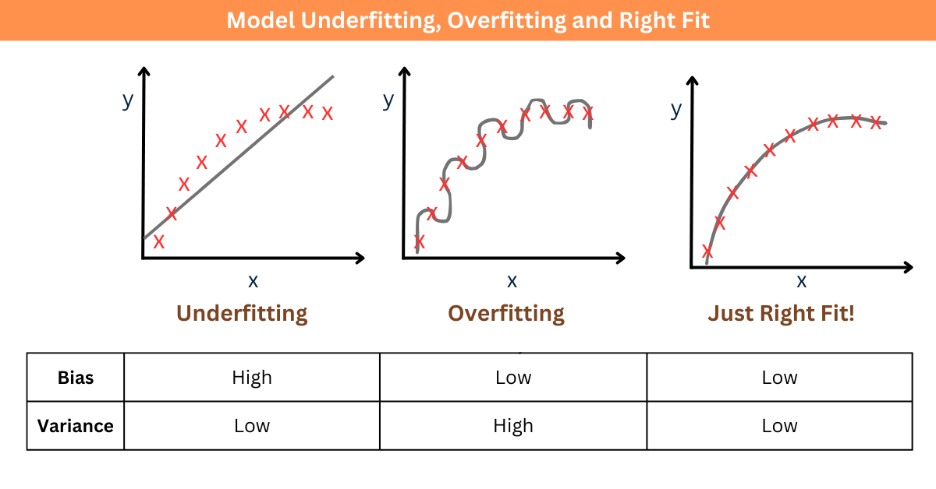
Underfitting
Model is too simple → misses even obvious patterns.
Symptoms:
Low accuracy on both training & test sets (unseen data)
Flat learning curves (no improvement with more data)
Example:
Predicting house price based on area, number of rooms, location score, etc.

Slide 14
Overfitting
Model is too complex → memorizes noise & outliers.
Symptoms:
High training accuracy, poor test accuracy
Validation loss rises while training loss keeps dropping

Slide 15
Just-Right Fit
Captures true pattern, ignores noise.
Symptoms:
Similar, high performance on train & test sets
Overfitting is memorizing;
underfitting is ignoring.
Good modeling is learning.

Slide 16

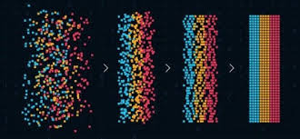
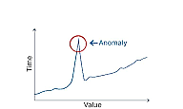
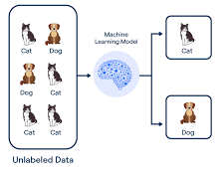
Unsupervised Learning
Definition:
The model finds patterns or groupings in unlabeled data.
Examples:
Anomaly detection, Pattern Recognition

Slide 17
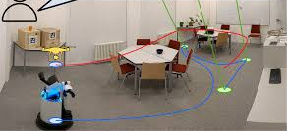
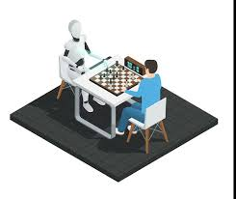
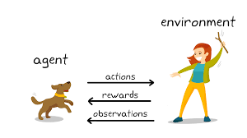
Reinforcement Learning
Definition:
The model learns by interacting with an environment and receiving rewards or penalties.
Examples:
Game-playing AI (e.g., AlphaGo), robotic navigation.

Slide 18
Types of Machine Learning
Type | Core Idea | Typical Data | Use-Cases | Key Algorithms
Supervised | Learn from labeled examples (input + correct output). | Labeled data: e.g., images tagged “cat” or “dog”. | Spam detection | Linear / Logistic regression, Random forest, SVM
Unsupervised | Discover hidden patterns without labels. | Unlabeled data. | Customer segmentation | K-Means, DBSCAN, Apriori
Semi-Supervised | Small labeled set + large unlabeled set. | Mix of the above. | Fraud detection | Self-training, Label propagation
Reinforcement | Agent learns by trial-and-error via rewards. | Environment + reward signals. | Game playing | Q-Learning, Deep RL

Slide 19
THANK YOU
Instructor : Fawad Bahadur

